Slide 1
Stakeholder Partner/Donor topics
What is the stakeholder entity?
What is different between partner and donor pages?
What is the partner assessment box?
What is the donor due diligence box?
What is the donor requirements box?
What are the different partner tabs?
What are the different donor tabs?
How does the partner cycle work?
How to request approval of partnership?
How to reflect reviews of PAs in the partner cycle?

Slide 2
What is the stakeholder entity?
The stakeholder entity allows to capture information and documentation about an organisation with whom CBM works.
The stakeholder entity has two categories: partner and donor. An organisation can only fit into one of the two categories.
Stakeholder pages are not created for individual persons e.g. consultants and service providers.
Stakeholder pages can be linked to other entities. For example, project and fundings.
Any user can create Stakeholder pages.

Slide 3

What is different between donor & partner pages?
Tab | Partner | Donor | Linkages with other entities
Partner assessment box (overview tab partner) |  |  | Appears on the overview of any project where the partner is a contract partner
Action plan box (overview tab partner) |  |  | Action plan tab is linked to the project where the partner is a contract partner
Due diligence box (overview tab donor) |  |  | Appears on all Funding pages with that Donor page selected as the Donor
Donor requirements box (overview tab donor) |  |  | Appears on donor & funding pages.
Workflow cycle tab |  |  | Appears only on partner pages

Slide 4
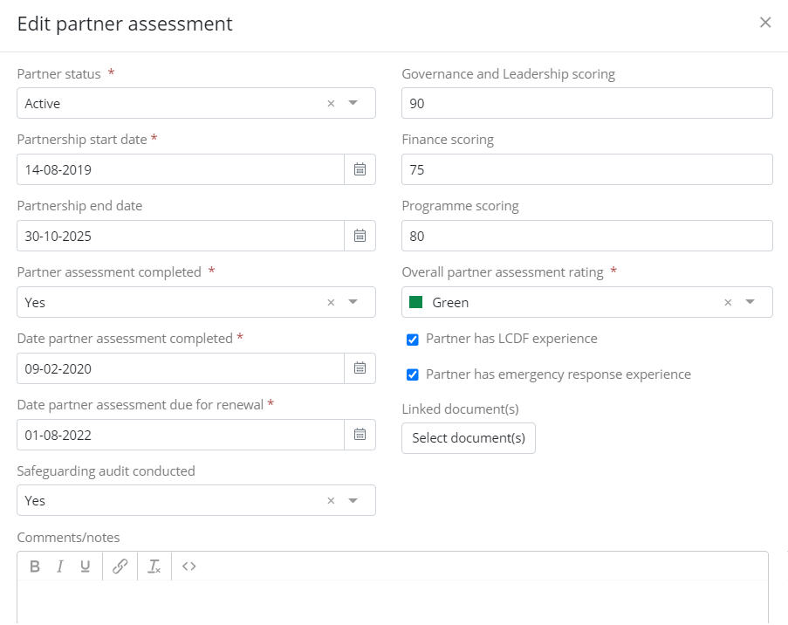
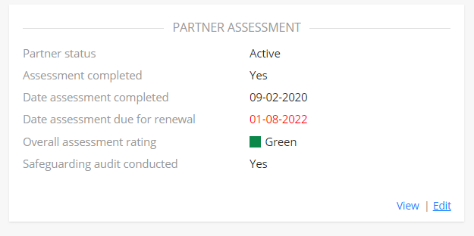
What is the partner assessment box?
The partner assessment box provides key information about the partner assessment and the organisation at a glance.
The box has to be completed manually. Information is found in the partner assessment tool.
The partner assessment box pulls through to appear on the overview of any Project with that partner selected as the ‘Contract partner’.

Slide 5
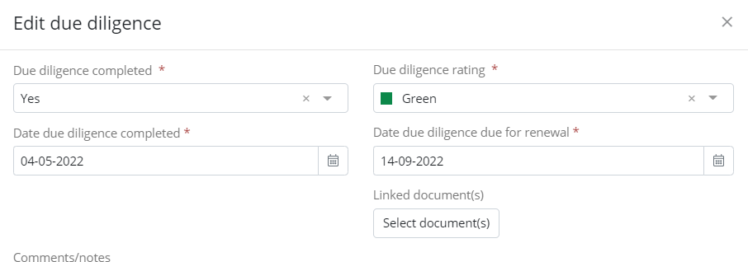
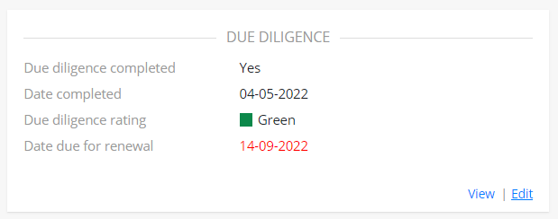
What is the donor due diligence box?
The due diligence overview box appears on Donor pages only.
The box allows to capture the outcome of due diligence processes conducted with donors.
The box has to be completed manually.
This is important for CBM global accountability reporting.

Slide 6
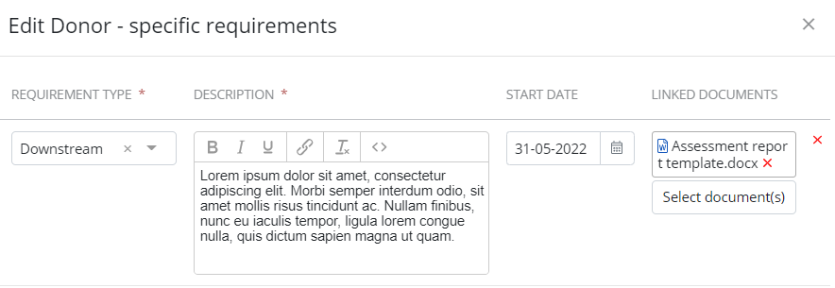
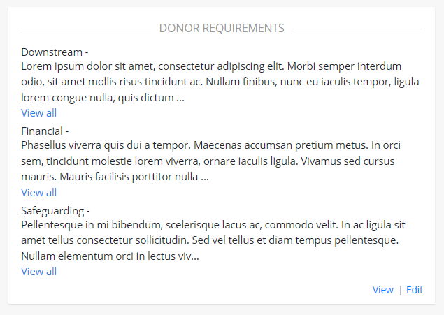
What is the donor requirements box?
The Donor requirements box allows requirements specific to the donor to be captured.
The box needs to be completed manually.
The information entered on the Donor page pulls through to all Funding and project pages where the donor is selected.
Specific or additional requirements for a funding opportunity/grant can be added on the dedicated funding page.
This is important for project implementation.

Slide 7

What are the different partner tabs?
The log tab is used to capture any decisions, recommendations, learnings etc from the partnership.
The action plan tab includes all the actions from the partner assessment action plan. The actions appear as read-only on any Projects and Programmes linked to the action.
The contacts tab is used for the contact details of individuals associated with a partner. The ‘main contact’ appears at the top of the list in bold. The contact identified as contact for contract is used for issuing of the project contract.
Partner bank accounts are added in the Bank account tab. Bank accounts linked to a project appear as read-only on the project page.

Slide 8
What are the different donor tabs?
The log tab is used to capture any decisions, recommendations, learnings etc from the donor.
The action plan tab includes any actions arising from the donor due diligence process.
The contacts tab is used for the contact details of individuals associated with the donor, if applicable.
No information is provided for the donor bank account tab.

Slide 9
How does the partner cycle work?
The partner cycle is based on the QPRG for Partnership and enables different types of partnership to be captured.
Task displayed in the cycle are selected based on the partner category and the stage of the partnership. For example, the task ‘Complete Part 1 of Partner assessment’ is only applicable to partnerships without flow of funds.
When a task is not applicable to the partner category, the status of the task should be updated to ‘Not applicable’.
Since partnerships can be ongoing for many years, the review of the partner assessment is pushed to the cycle tab as many times as needed.
As a reminder to the team working with the partner, a task can be set with a 3 year deadline as a reminder to review the partner assessment.

Slide 10
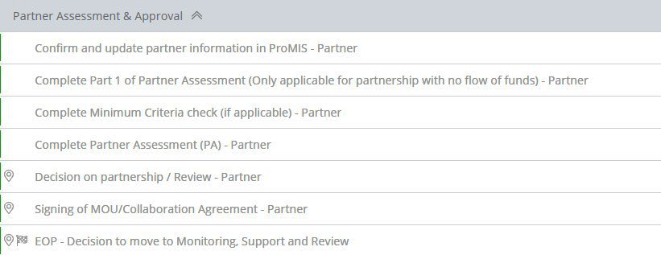
How to request approval of partnership?
The task ‘Complete part 1 of Partner Assessment’ only has to be completed for partnerships without flow of funds. For other types of partnership update the status of the task to ‘Not applicable’.
The task ‘Complete Minimum Criteria check’ is only applicable in specific situations (see QPRG for Partnership). If the specific situation is not relevant to your partnership, the status of the tasks should be updated to ‘Not applicable’
The task ‘decision on partnership’ is applicable to all partnership with funding and can only be completed when a complete partner assessment has been conducted and is available.

Slide 11
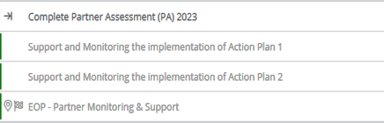
How to reflect reviews of PAs in the partner cycle?
Monitoring, support and review
Task ‘review of partnership’ to be created and pushed in this phase with the year of the PA review.
A Partner Assessment Review task template is available and ready to push to the cycle. Add the year of the review to the name of the task.
The ‘review of partnership’ task should be pushed to the partner cycle whenever needed, until a decision is made to exit the partnership.

